Slide 1
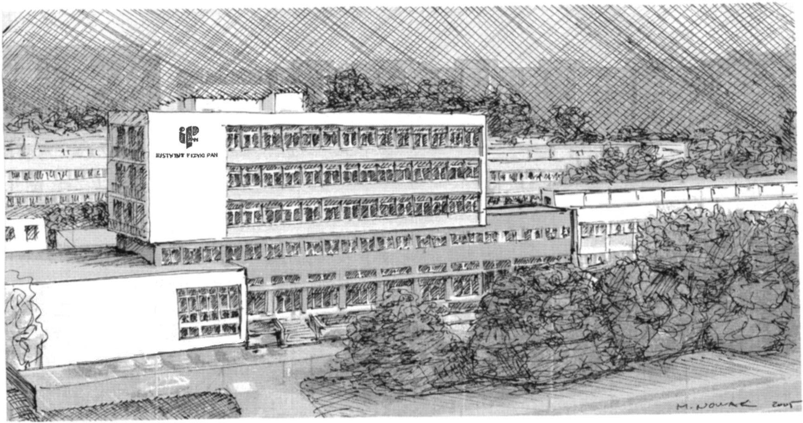
Missing level statistics of microwave networks with violated time reversal symmetry
Michał Ławniczak, Małgorzata Białous, Barbara Dietz,
Szymon Bauch, Vitalii Yunko and Leszek Sirko
Institute of Physics, Polish Academy of Sciences, Aleja Lotników 32/46, 02-668 Warszawa, Poland

Slide 2
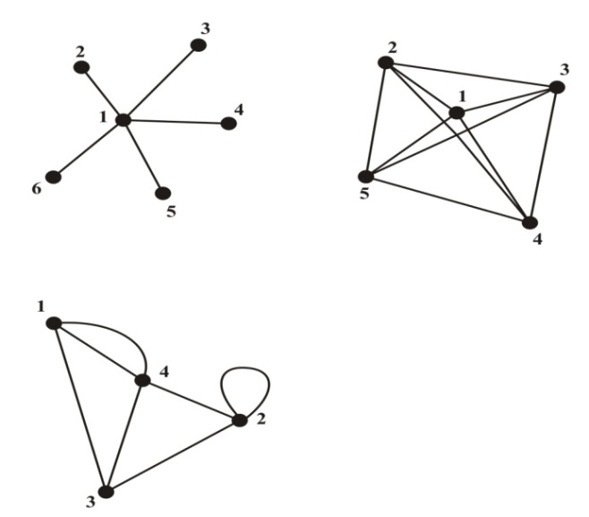
Quantum chaotic systems
Quantum graphs
Quantum graphs were introduced by Linus Pauling
in 1936.
Quantum graphs are excellent paradigms of quantum chaotic systems.

Slide 3
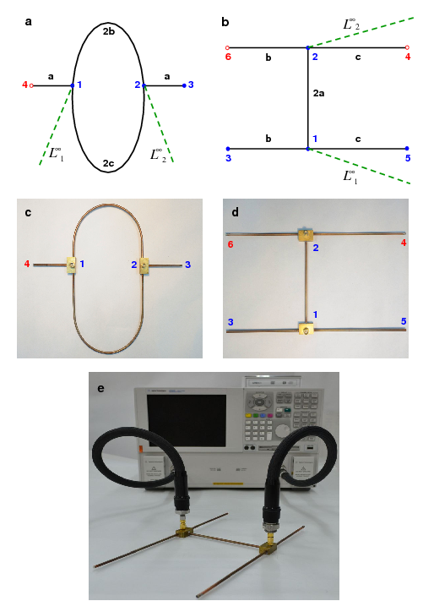
Microwave isoscattering graphs
O. Hul, M. Ławniczak, S. Bauch, A. Sawicki, M. Kuś, and L. Sirko, Phys. Rev. Lett 109, 040402 (2012).

Slide 4
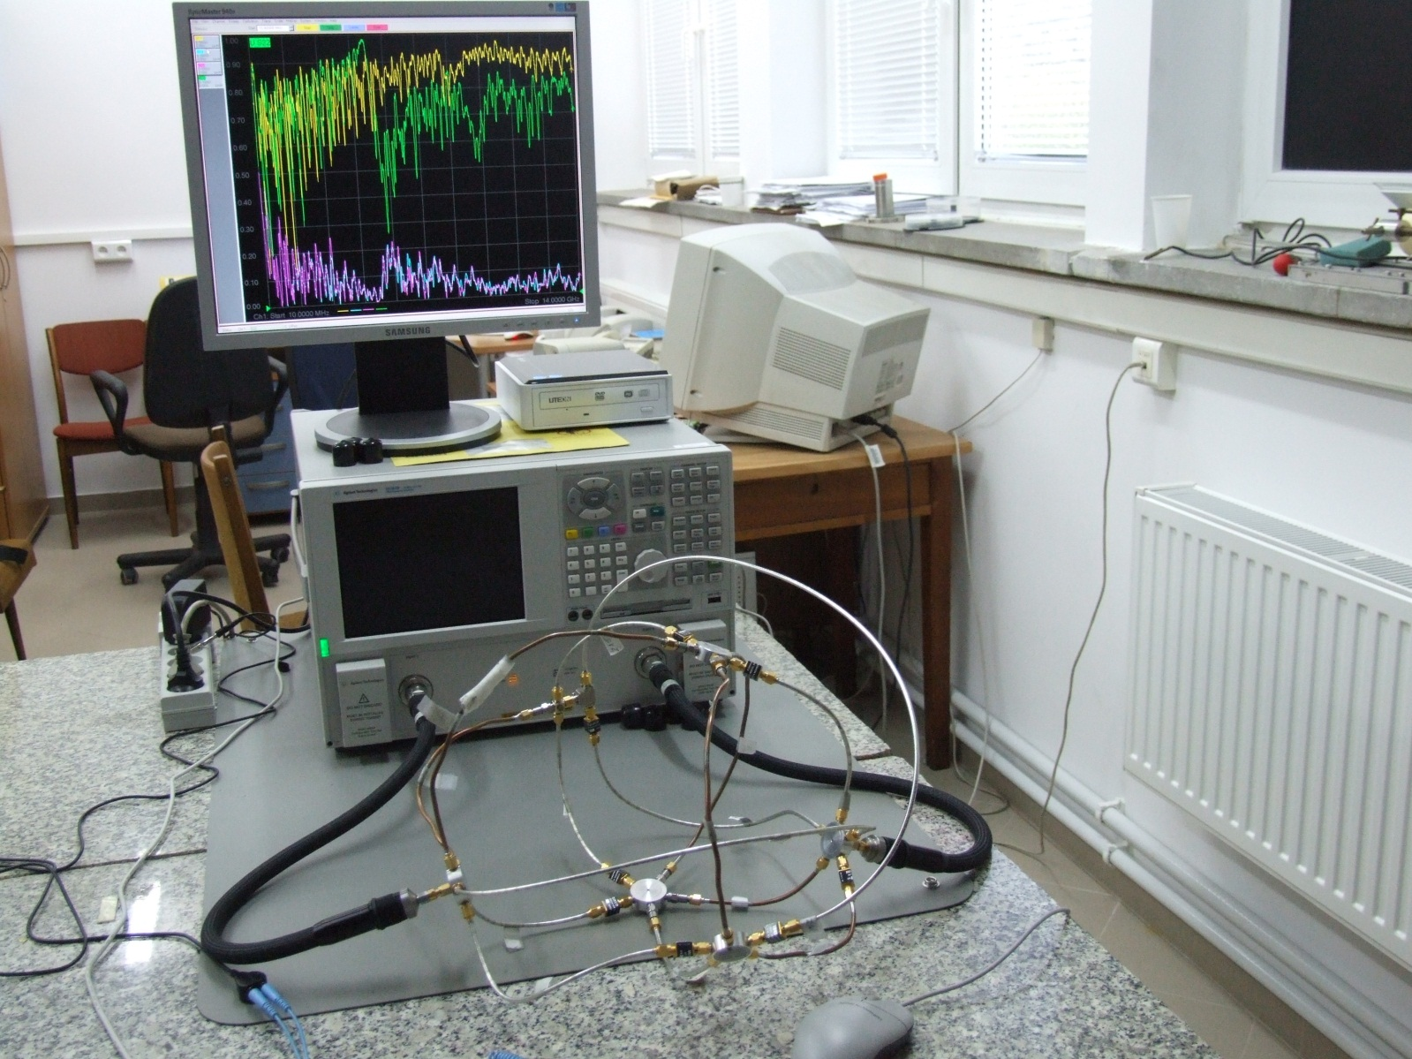
Experimental set-up for measuring of hexagonal graphs with time reversal symmetry

Slide 5
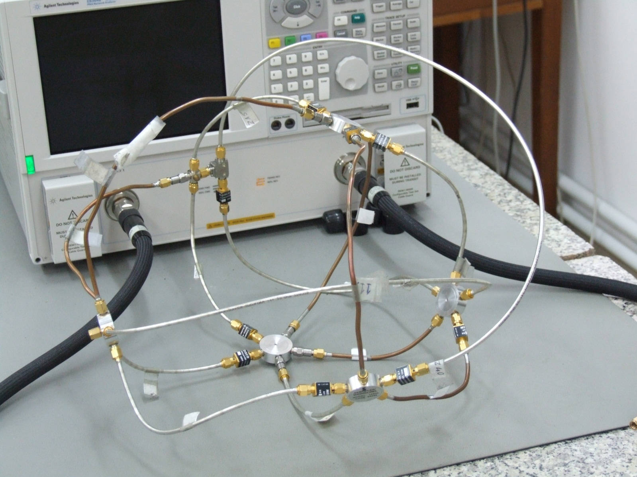
An example of a hexagonal microwave network with a microwave circulator
which was used to simulate quantum graphs with broken time reversal
symmetry

Slide 6
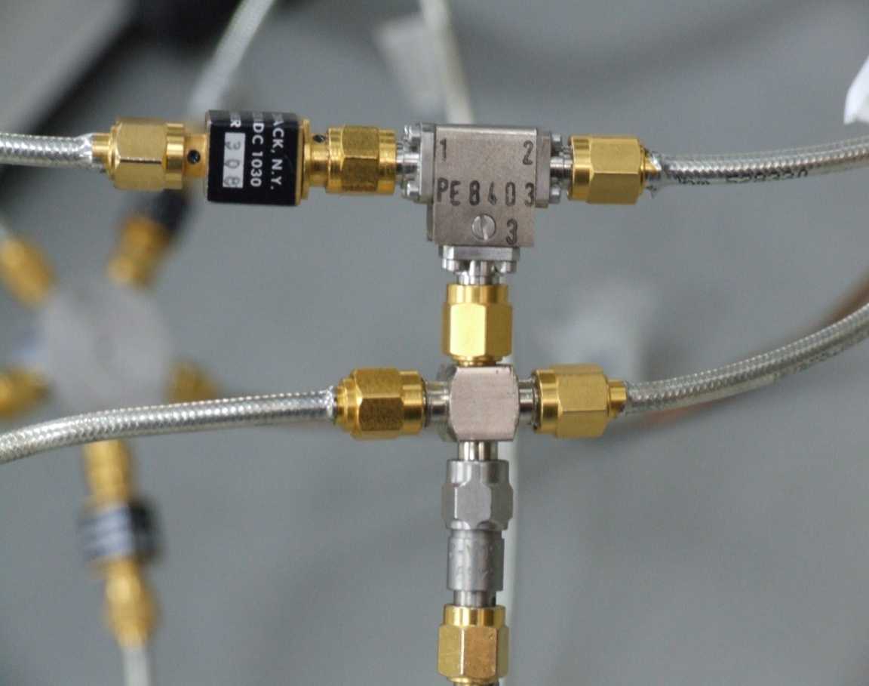
Using microwave networks with circulators one can simulate quantum graphs with broken time reversal symmetry (GUE in RMT).
M. Ławniczak, S. Bauch, O. Hul, and L. Sirko, Phys. Rev. E 81, 046204 (2010).

Slide 7
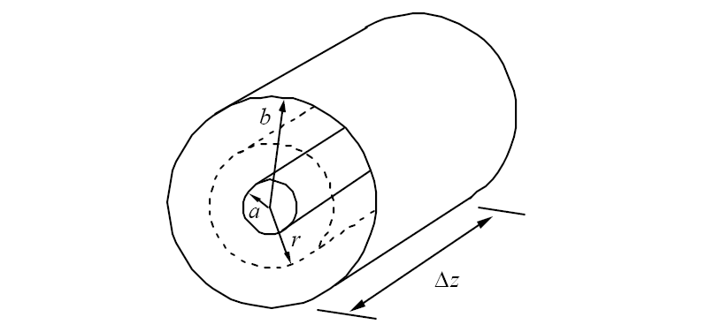
A coaxial cable segment
(a = 0.05 cm, b = 0.15 cm)

Slide 8
Propagation inside a coaxial cable
In order to find propagation of a wave inside the coaxial cable joining the i-th and the j-th vertex of the microwave graph we begin with the continuity equation for the charge and the current on the considered cable (bond)
(1)
where and are the charge and the current per unit length on the surface of the inner conductor of a coaxial cable.
For the potential difference we can write down
(2)
where and are the potentials of the inner and the outer conductors of a coaxial cable and is the capacitance per unit length of a cable.

Slide 9
Making use of the equations (1) and (2) for an ideal lossless coaxial cable
and assuming that along the cable propagates a monochromatic wave, one can derive the telegraph equation on the microwave network
(3)
Assuming the following correspondence and ,
the equation (3) is formally equivalent to the one-dimensional Schrödinger
equation (with ) on the graph
(4)

Slide 10
Random matrix theory (RMT)
Hamiltonians of systems with time reversal symmetry (universal class β = 1, Gaussian Orthogonal Ensemble (GOE) in RMT). Hamiltonians are represented by orthogonal matrices.
Hamiltonians of systems with broken time reversal symmetry (universal class β = 2, Gaussian Unitary Ensemble (GUE) in RMT). Hamiltonians are Hermitian matrices.
Hamiltonians of half spin systems with time reversal symmetry (universal class β = 4, Gaussian Simplectic Ensemble (GSE) in RMT). Hamiltonians are quaternion matrices.
O. Hul, S. Bauch, P. Pakoński, N. Savytskyy, K. Życzkowski, and L. Sirko, Phys. Rev. E 69, 056205 (2004).
O. Hul, S. Bauch, P. Pakoński, N. Savytskyy, K. Życzkowski, and L. Sirko, Phys. Rev. E 69, 056205 (2004).
M. Ławniczak, S. Bauch, O. Hul, and L. Sirko, Phys. Rev. E 81, 046204 (2010).
A. Rehemanjiang, M. Allgaier, C. H. Joyner, S. Müller, M. Sieber, U. Kuhl, and H.-J. Stöckmann, Phys. Rev. Lett. 117, 064101 (2016).

Slide 11
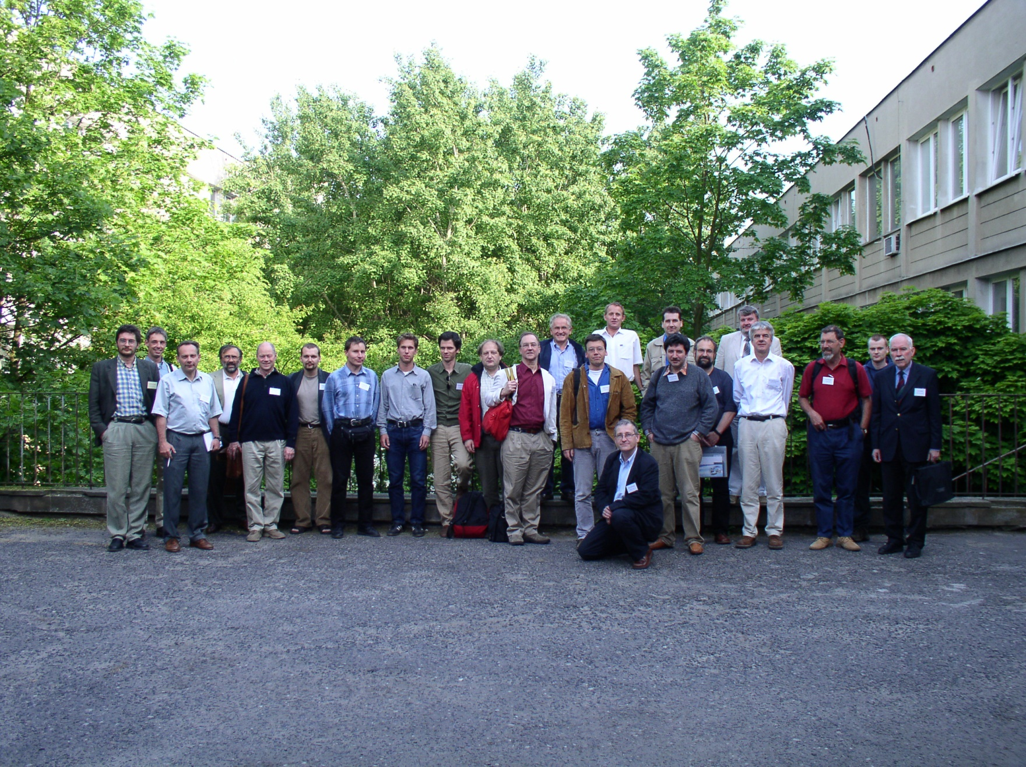
Workshop on Quantum Chaos and Localisation Phenomena, Warszawa, May 24, 2003

Slide 12
Common publications
1. M. Ławniczak, O. Hul, S. Bauch, P. Šeba, and L. Sirko, Experimental and numerical investigation
of the reflection coefficient and the distributions of Wigner’s reaction matrix for irregular graphs with absorption,
Physical Review E 77, 056210 (2008).
2. O. Hul, P. Šeba, and L. Sirko, Departure of some parameter-dependent spectral statistics of irregular quantum
graphs from random matrix theory, Phys. Rev. E 79, 066204 (2009).
3. O. Hul, P. Šeba, and L. Sirko, Investigation of parameter-dependent properties of quantum graphs
with and without time-reversal symmetry, Phys. Scr. T135, 014048 (2009).
O. Hul, P. Šeba, and L. Sirko, Investigation of quantum graphs and microwave networks,
Book of Abstracts of the 3rd Workshop on Quantum Chaos and Localisation Phenomena, Warsaw, Poland ,
p. 16, 25-27.05.2007.
M. Ławniczak, O. Hul, S. Bauch, P. Šeba, and L. Sirko, Investigation of graphs with different time reversal symmetries,
15th Central European Workshop on Quantum Optics CEWQO 2008 Book of Abstracts, 4 (2008).
O. Hul, P. Šeba, and L. Sirko, Investigation of autocorrelation functions of level velocities for quantum graphs,
International Workshop “Mathematical Aspects of Quantum Chaos”, Montreal, Canada, 02-07.06.2008.
O. Hul, M. Ławniczak, Sz. Bauch, P. Šeba, and L. Sirko, Quantum graphs and microwave networks,
Physics of Social Systems, Hradec Kralove, Czech Republic, 27-28.11.2008.
O. Hul, M. Ławniczak, S. Bauch, P. Šeba, and L. Sirko, Investigation of graphs with absorption,
4th Workshop on quantum chaos and localization phenomena”, Warszawa, Poland, Book of Abstracts,
p. 16 , 22-24.05.2009.
O. Hul, M. Ławniczak, S. Bauch, P. Šeba, and L. Sirko, Investigation of scattering properties of graphs with absorption,
31.08-4.09.2009, “Dynamic days Europe 2009”, Goettingen, Germany, Book of Abstracts, 207 (2009).
O. Hul, P. Šeba, and L. Sirko, Parameter-dependent spectral statistics of quantum graphs,
Book of Abstracts International Conference “QMath 11, Mathematical Results in Quantum Physics”,
Hradec Kralove, Czech Republic, 06-10.09.2010.

Slide 13
Statistics of Wigner’s reaction matrix K
In the case of a single channel antenna experiment Wigner's reaction matrix is related to the scattering matrix by the following relation
It is interesting that the function has a direct physical meaning of the electric impedance that has been recently measured in the microwave cavity experiment. In a one channel case the matrix can be parameterized as
where is the reflection coefficient and the phase.

Slide 14
In the case of time reversal systems the distributions of the reflection coefficient and the imaginary and real parts of the matrix are given by the formulas
(D. Savin et al, JETP Lett. 82, 544 (2005)):
(5)
(6)
(7)
where is the probability distribution, is the imaginary
and is the real part of the matrix, respectively.

Slide 15
The probability distribution depends on the absorption strength
where is the absorption width and is the mean level spacing.
The absorption strength was estimated by adjusting the theoretical mean
reflection coefficient:
to the experimental one:

Slide 16
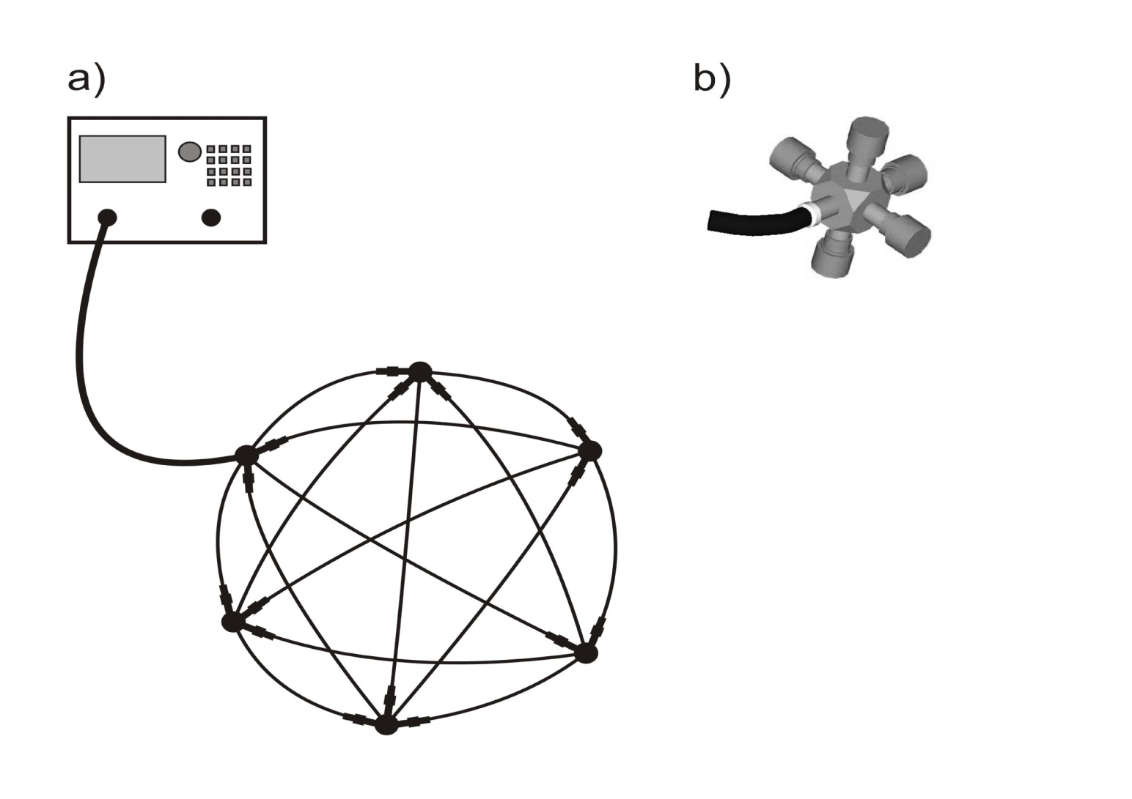
(a) Experimental set-up used to measure the scattering matrix of fully
connected irregular hexagon microwave graphs with absorption.
(b) Scheme of the setup used to measure the radiation scattering matrix .

Slide 17
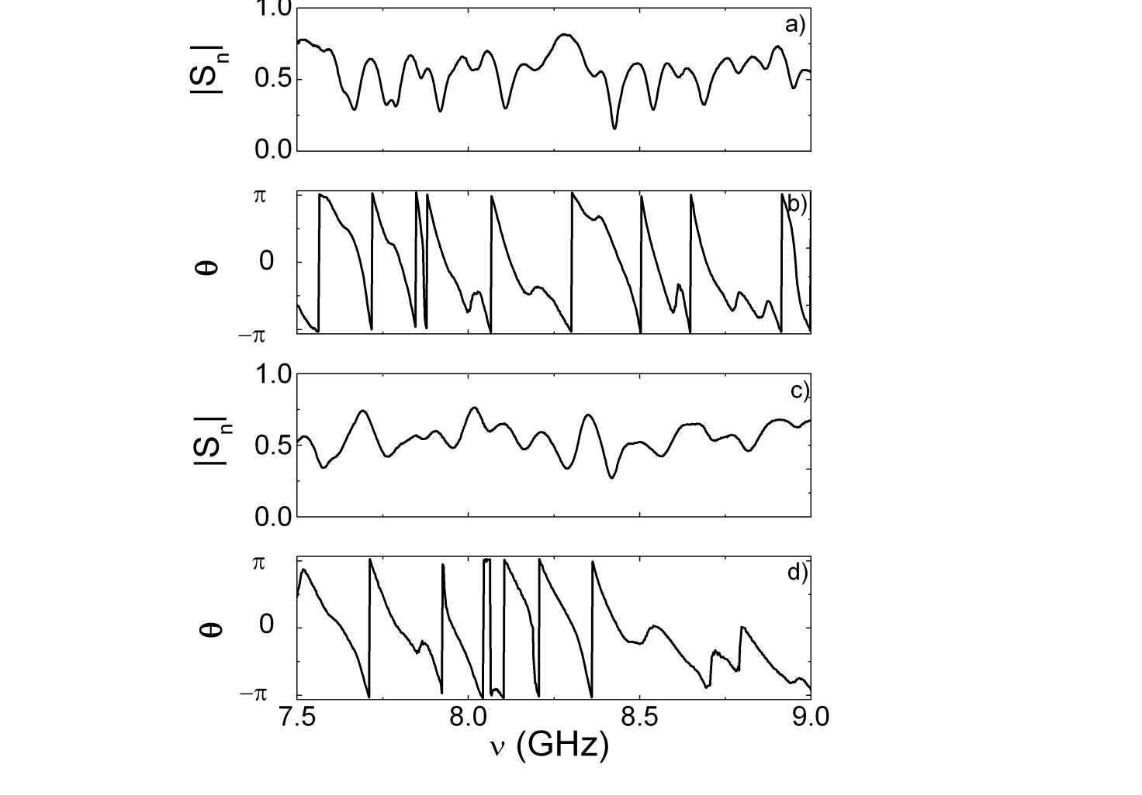
Panels (a) and (b): the modulus and the phase of the scattering matrix measured for the graph with absorption parameter = 19.9 with use of 1 dB attenuators. Panels (c) and (d): measurements for the graph with = 47.9 with use of 2 dB attenuators.

Slide 18
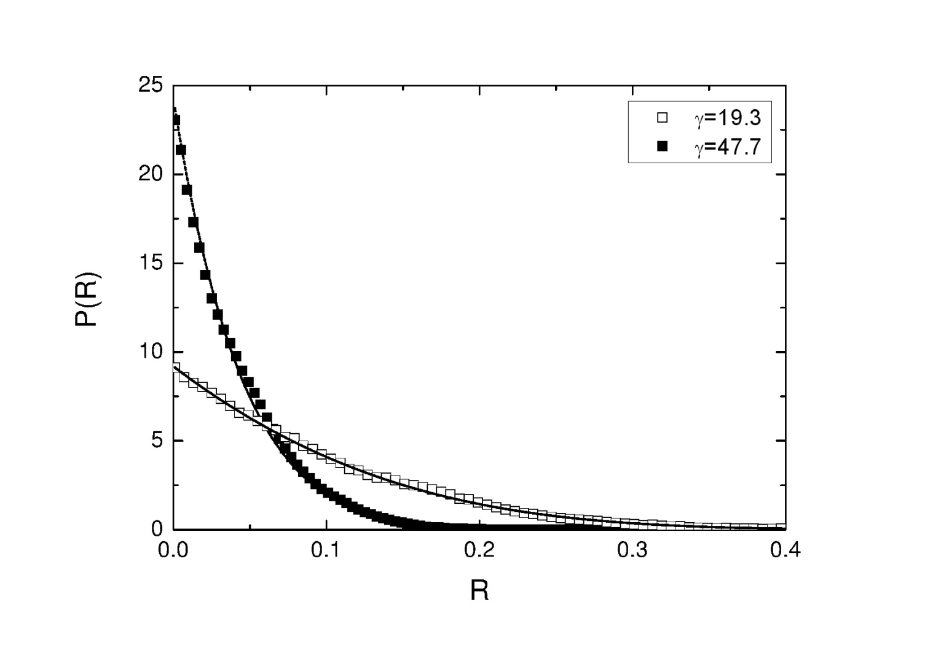
Experimental distribution of the reflection coefficient at different
values of the mean absorption parameter: = 19.3 (open squares)
and = 47.7 (full squares).
Each corresponding theoretical distribution evaluated from Eq. (5) is also
shown, respectively.

Slide 19
A model of an attenuator
N = 12

Slide 20
Modelling of attenuators by optical
potentials
The experimentally measured fully connected hexagon networks were described in numerical calculations by quantum fully connected hexagon graphs with one lead attached to the six-joint vertex. In the calculations, attenuators were modeled by optical potentials:
The potentials were equally spaced inside the length of the absorbing element. We used N=10 potentials with b=0.028 for simulation of the 1 dB attenuators and N=12 potentials with b=0.045 for the 2 dB attenuators.

Slide 21
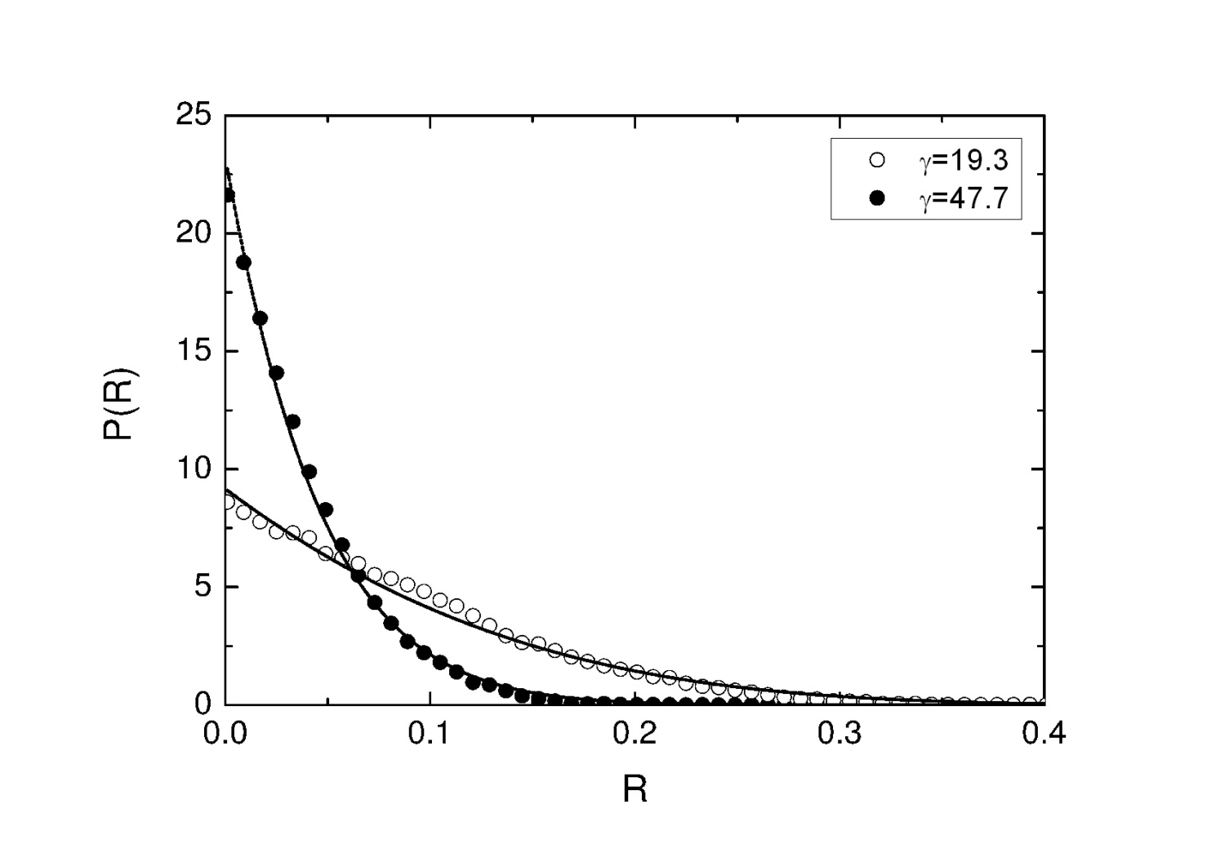
Numerical distribution of the reflection coefficient at different
values of the mean absorption parameter: = 19.3 (open circles)
and = 47.7 (full circles).
Each corresponding theoretical distribution evaluated from Eq. (5) is also
shown, respectively.

Slide 22
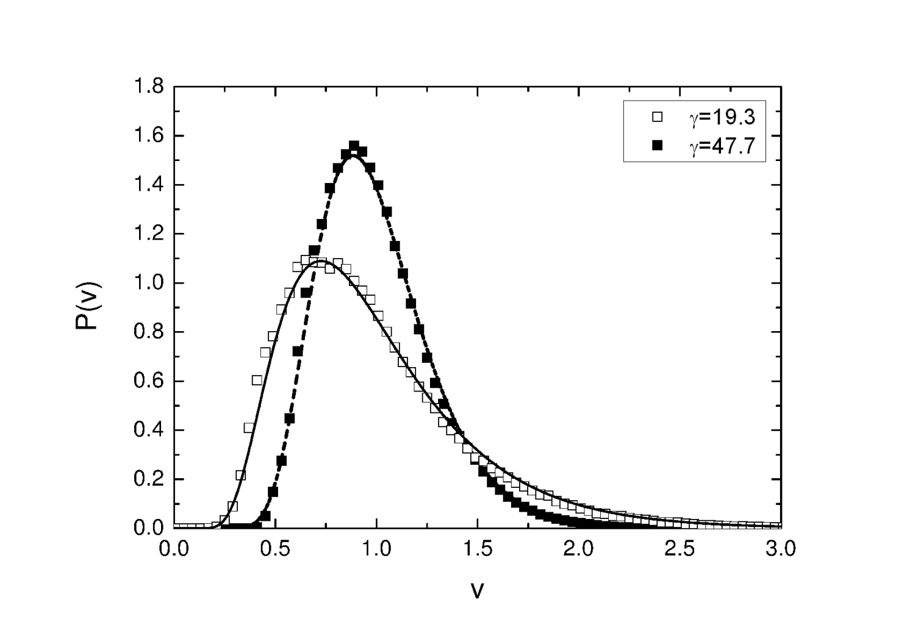
Experimental distribution of the imaginary part of the matrix at different
values of the mean absorption parameter: = 19.3 (open squares) and
= 47.7 (full squares).
Each corresponding theoretical distribution evaluated from Eq. (6) is also
shown, respectively.

Slide 23
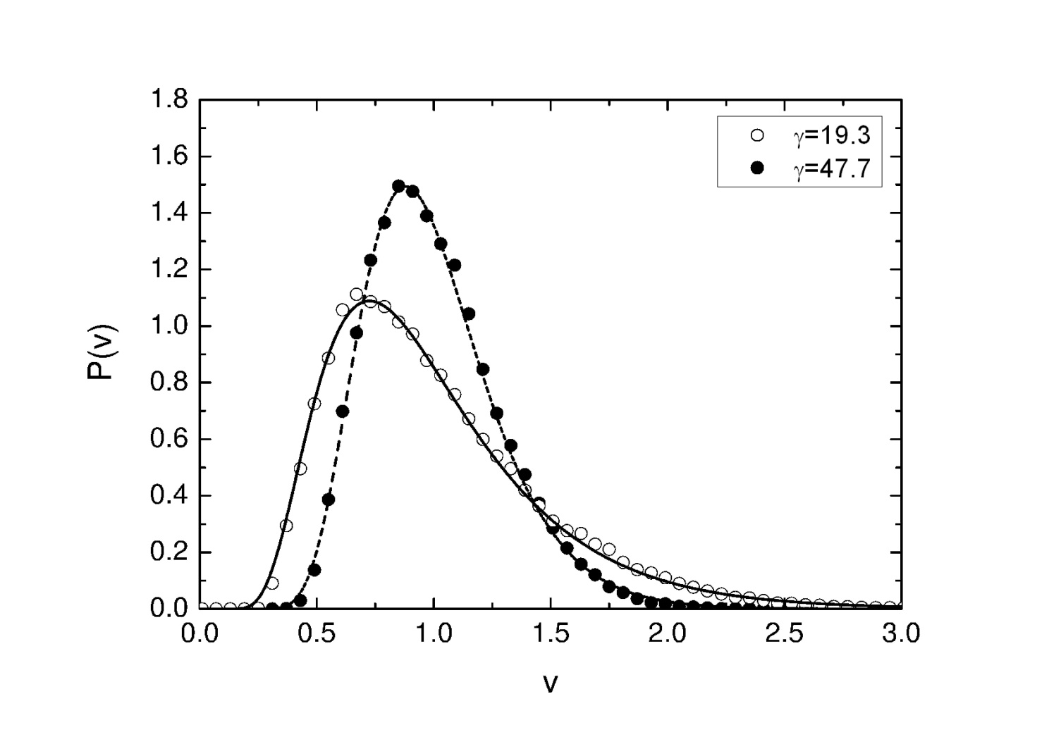
Numerical distribution of the imaginary part of the matrix at different
values of the mean absorption parameter: = 19.3 (open circles) and
= 47.7 (full circles). Each corresponding theoretical distribution
evaluated from Eq. (6) is also shown, respectively.

Slide 24
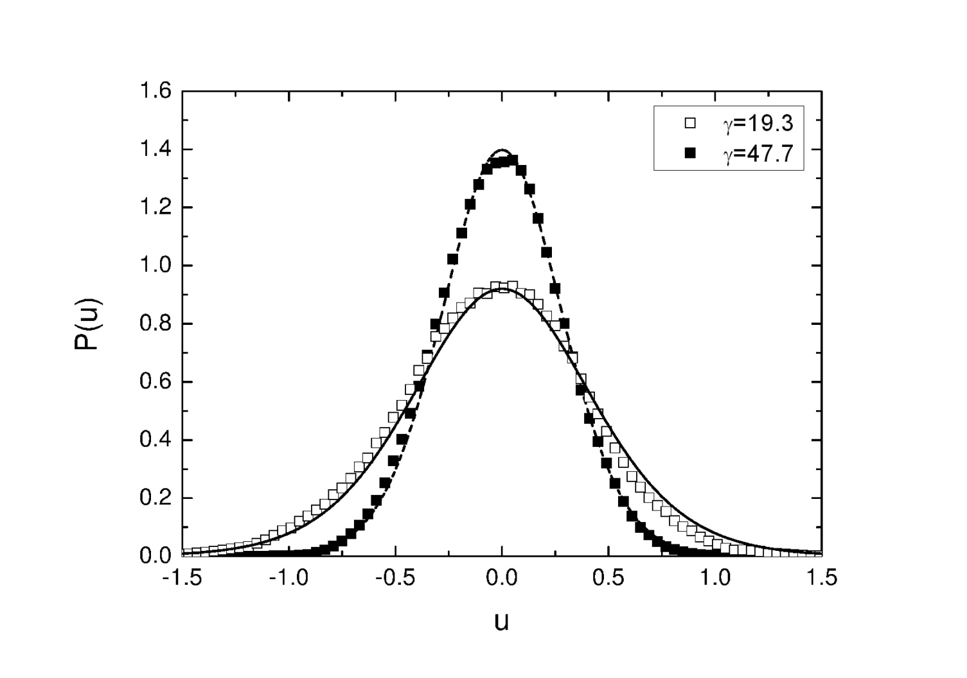
Experimental distribution of the real part of the matrix at different
values of the mean absorption parameter: = 19.3 (open squares) and
= 47.7 (full squares). Each corresponding theoretical distribution
evaluated from Eq. (7) is also shown, respectively.

Slide 25
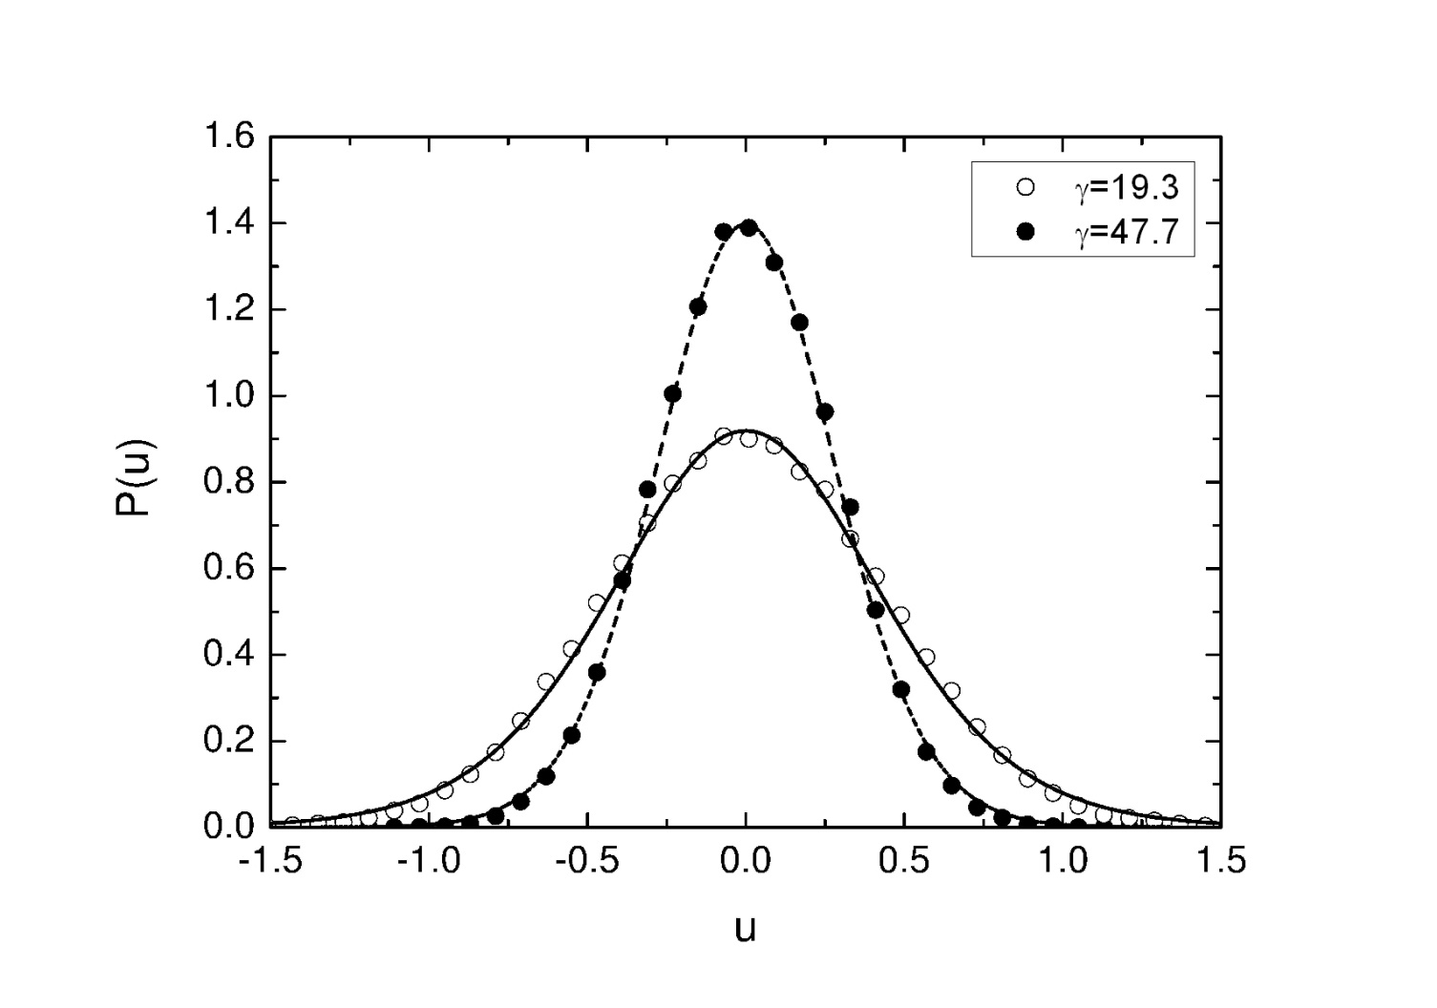
Numerical distribution of the real part of the matrix at different
values of the mean absorption parameter: = 19.3 (open circles) and
= 47.7 (full circles). Each corresponding theoretical distribution
evaluated from Eq. (7) is also shown, respectively.

Slide 26
Conclusions
We measured and calculated numerically distribution of the reflection
coefficient and the distributions and of imaginary
and real parts of Wigner's reaction matrix for irregular fully connected
hexagon networks and graphs in the presence of strong absorption.
In the numerical calculations absorption in attenuators was modeled
by an optical potential.
We showed that the experimental and numerical results for ,
and are in good overall agreement with the theoretical
predictions.

Slide 27
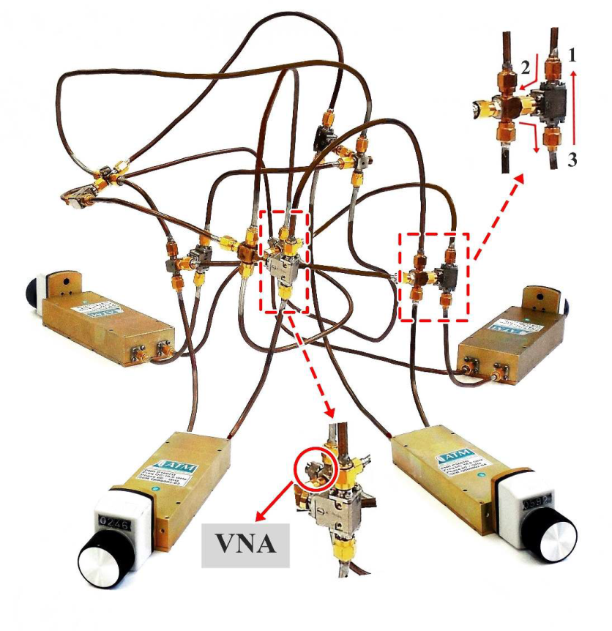
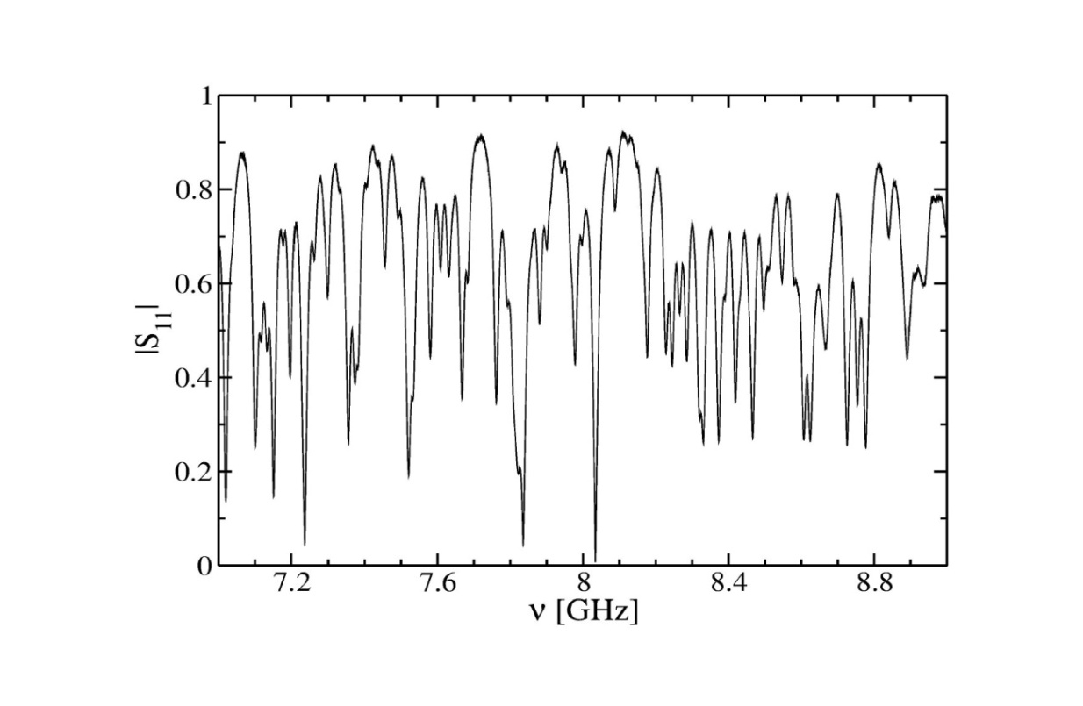
Missing level statistics of microwave networks with violated time reversal symmetry
Experimental Setup

Slide 28
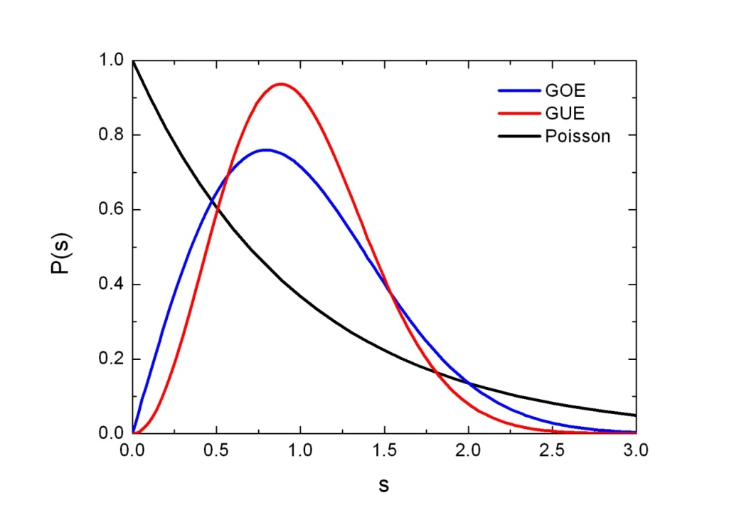
The level spacing distribution
The spaces between the nearest neighbors:
where:
if all levels in the investigated energy range are known.
For integrable systems:
For GOE systems:
For GUE systems:

Slide 29
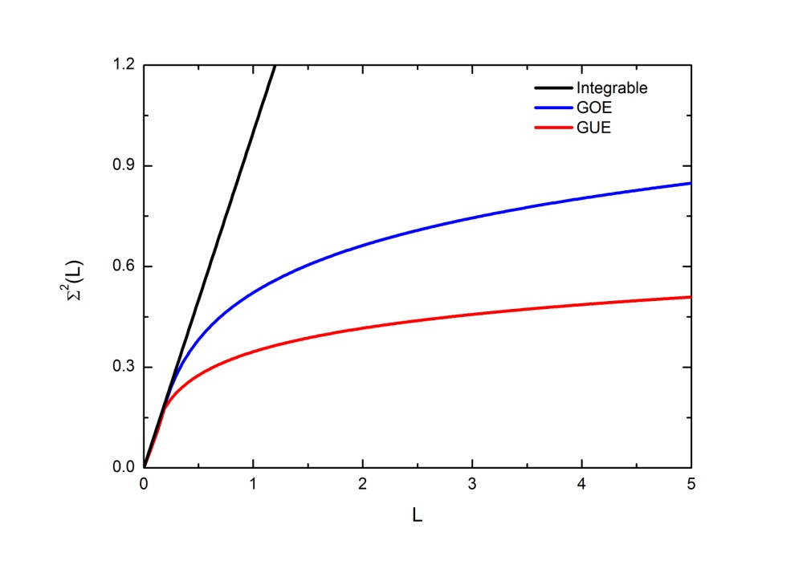
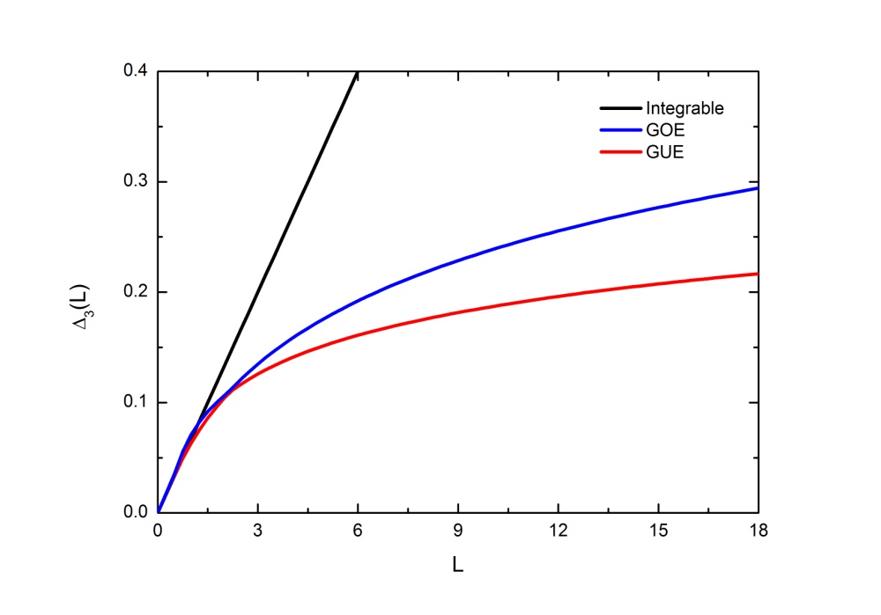
Long-range correlations:
the Number Variance and the Spectral rigidity
where:
is the parameter describing the fraction of the observed levels.
for the complete spectra.
O. Bohigas and M. P. Pato, Phys. Lett. B 595, 171 (2004).

Slide 30
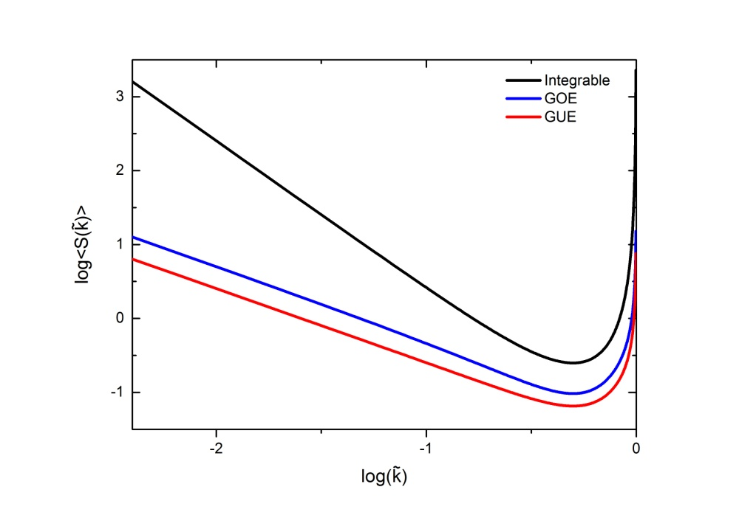
The power spectra S(k) of discrete and finite series of eigenenergies
The spaces between the nearest neighbors:
where:
The spectral fluctuations:
The power spectra S(k) is obtained from the Fourier
spectrum from `time` n to k of the deviation of the n-th
nearest neighbor spacing from its mean value n:
A. Relaño, J. M. G. Gómez, R. A. Molina, J. Retamosa, and E. Faleiro, Phys. Rev. Lett. 89, 244102 (2002).

Slide 31
where:
the parameter describing the fraction of the observed levels,
, 1 is for the complete spectra.
- the form factor function. Its shape depends on the class of symmetry, for GOE, for GUE
R. A. Molina, J. Retamosa, L. Muñoz, A. Relaño, and E. Faleiro, Phys. Lett. B 644, 25 (2007).

Slide 32
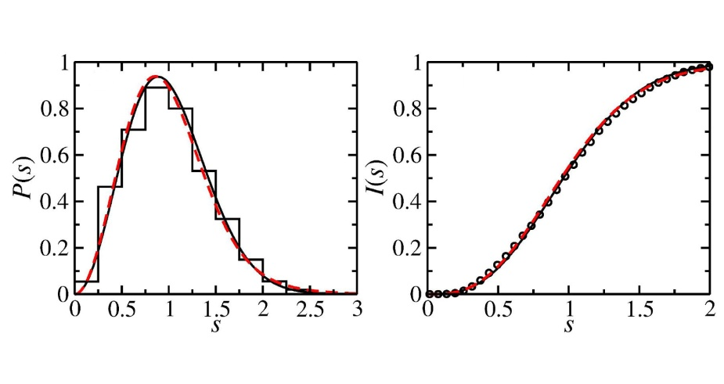
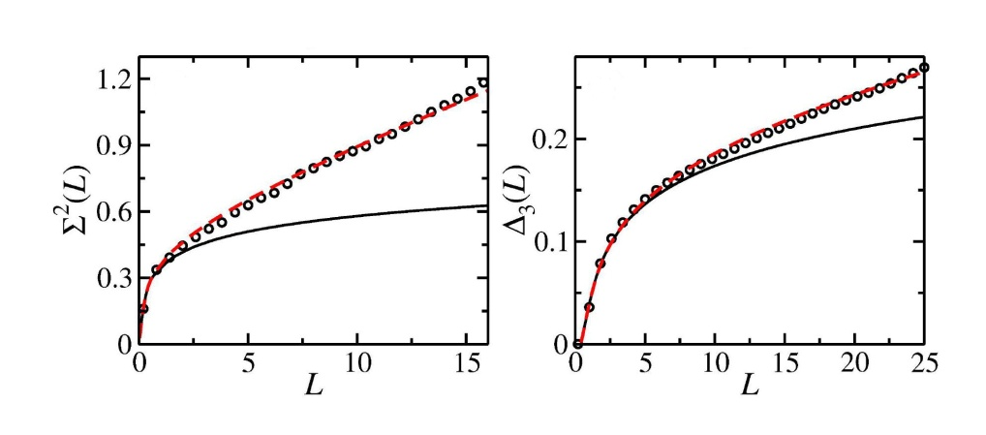
Results
The level spacing distribution:
$$− GUE$$
$$− GUE$$
The number variance and the spectral rigidity:
$$− GUE$$
$$− GUE$$
The analysis shows that we delt with the system possesing broken time reversal symmetry for which 3.5 % of energy levels were lost . Experiment - empty circles; theory - red broken line.
M. Białous, V. Yunko, S. Bauch, M. Ławniczak, B. Dietz, and L. Sirko, Phys. Rev. Lett. 117, 144101 (2016).

Slide 33
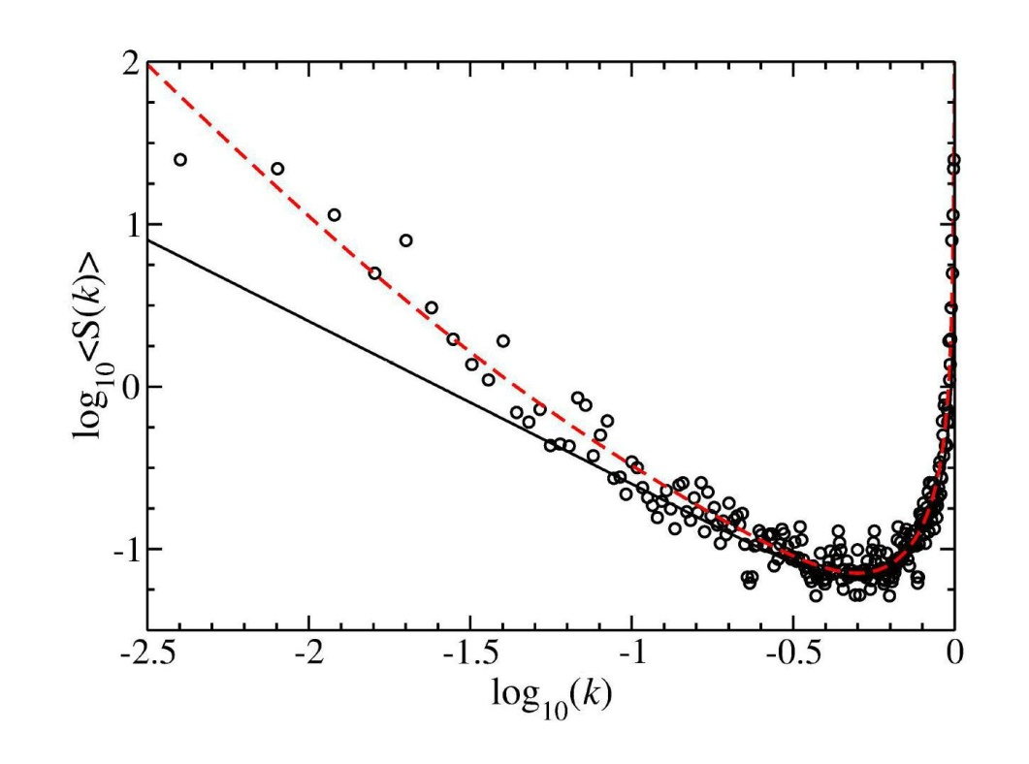
Results
$$− GUE$$
The power spectrum S(k) for the system with broken time reversal symmetry
for which 3.5 % of energy levels were lost. Experiment - empty circles; theory - red broken line.
M. Białous, V. Yunko, S. Bauch, M. Ławniczak, B. Dietz, and L. Sirko, Phys. Rev. Lett. 117, 144101 (2016).

Slide 34
Conclusions
Is it possible to obtain information about symmetry
and missing energy levels of the system?
Yes, if we use both, short- and long-range, correlation functions
to analyze the energy spectra.
This information is supplemented by the power spectrum
which is especially sensitive to the symmetry
of the system and the missing energy levels.
M. Białous, V. Yunko, S. Bauch, M. Ławniczak, B. Dietz, and L. Sirko, Power Spectrum Analysis and Missing Level Statistics of Microwave Graphs with Violated Time Reversal Invariance, Phys. Rev. Lett. 117, 144101 (2016).

